Slide 1
Using the Storyboard
INFO 6350

Slide 2
Storyboard
Visual representation of the user interface of an iOS application
Shows screens of content and the connections between those screens
Composed of a sequence of scenes, connected by segue objects.
Scene:
  a single view controller and its views
Segue:
  represent a transition between two view controllers.

Slide 3
Using Storyboard
A scene represents an onscreen content area that is managed by a view controller.
You can think of a scene as a view controller and its associated view hierarchy.
Relationships are created between scenes in the same storyboard

Slide 4
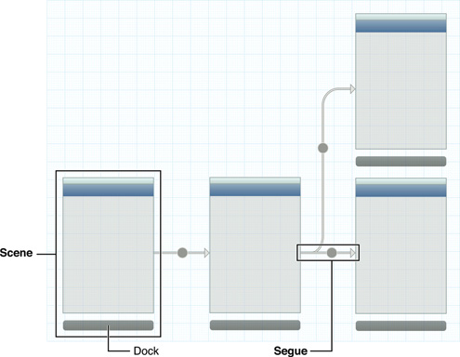

Slide 5
Containment
  represents a parent-child relationship between two scenes.
  View controllers contained in other view controllers are instantiated when their parent controller is instantiated.
  Ex, the first connection from a navigation controller to another scene defines the first view controller pushed onto the navigation stack. This controller is automatically instantiated when the navigation controller is.
  IB can adjust the appearance of the child view controller to reflect the presence of its ancestors.
A segue
  represents a visual transition from one scene to another.
  At runtime, segues can be triggered by various actions.
    Programatically : usually for segue that directly connect two view controllers
    By a third object such as a Button in the source view controller
  When a segue is triggered, it causes a new view controller to be instantiated and transitioned onscreen..

Slide 6
Kind of Segues
A push segue pushes the destination view controller onto a navigation controller’s stack. 3
A modal segue presents the destination view controller. 1
A popover segue displays the destination view controller in a popover. (弹出)
A custom segue allows you to design your own transition to display the destination view controller. （addsubview）

Slide 7
func awakeFromNib() :
  used to finish initializing all objects loaded from a story board, including view controllers
  When an object receives an awakeFromNib message, it is guaranteed to have all its outlet and action connections already established.
Segue transitions:
  Push
  Modal
  Custom: subclass a segue object to implement a custom transition.
optional func prepare(for segue: NSStoryboardSegue, sender: Any?)
  Used to pass data between scenes.
  Invoked on the view controller when a segue is triggered.
optional func performSegue(withIdentifier identifier: NSStoryboardSegue.Identifier, sender: Any?):
  Used to programmatically force a transition on the view controller
optional func shouldPerformSegue(withIdentifier identifier: NSStoryboardSegue.Identifier, sender: Any?) -> Bool
  Called immediately prior to the performance of a storyboard segue.

Slide 8
UIStoryBoard Class
A UIStoryboard object encapsulates the view controller graph stored in an Interface Builder storyboard resource file.
View controllers in a storyboard are instantiated and created automatically in response to actions defined within the storyboard itself.
Can use a storyboard object to instantiate the initial view controller in a storyboard file or instantiate other view controllers to present them programmatically.
init(name: String, bundle storyboardBundleOrNil: Bundle?)
  Creates and returns a storyboard object for the specified storyboard resource file.
func instantiateInitialViewController() -> UIViewController?
  Instantiates and returns the initial view controller in the view controller graph
func instantiateViewController(withIdentifier identifier: String) -> UIViewController:
  Instantiates and returns the view controller with the specified identifier.

Slide 9
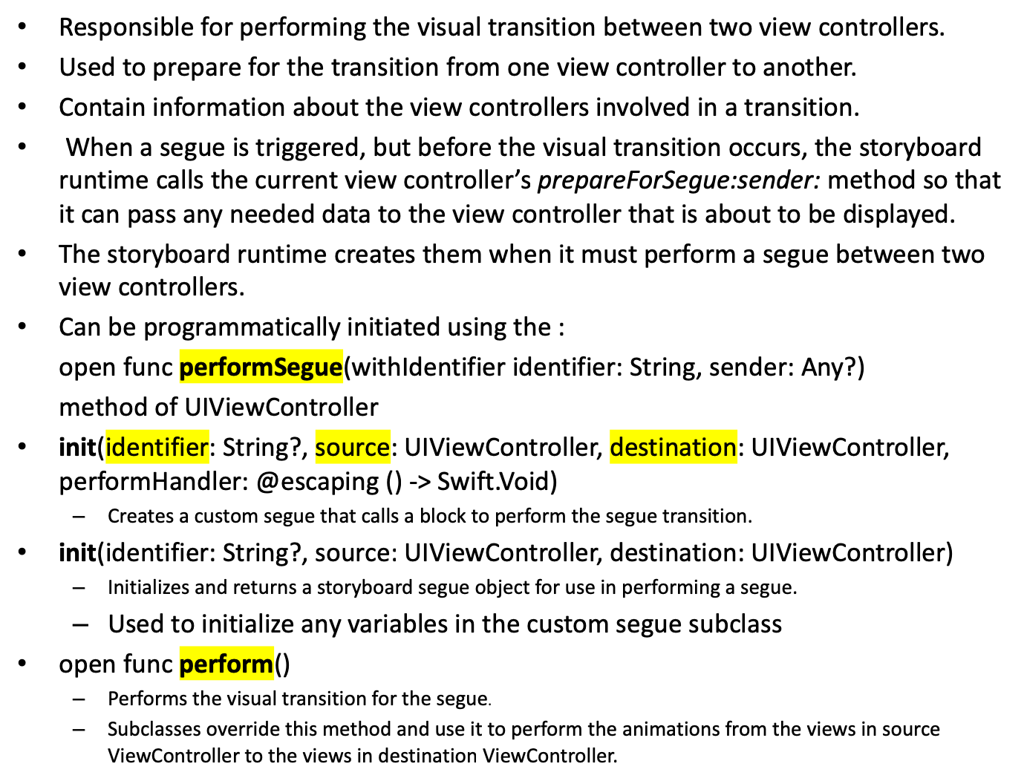
UIStoryboardSegue

Slide 10
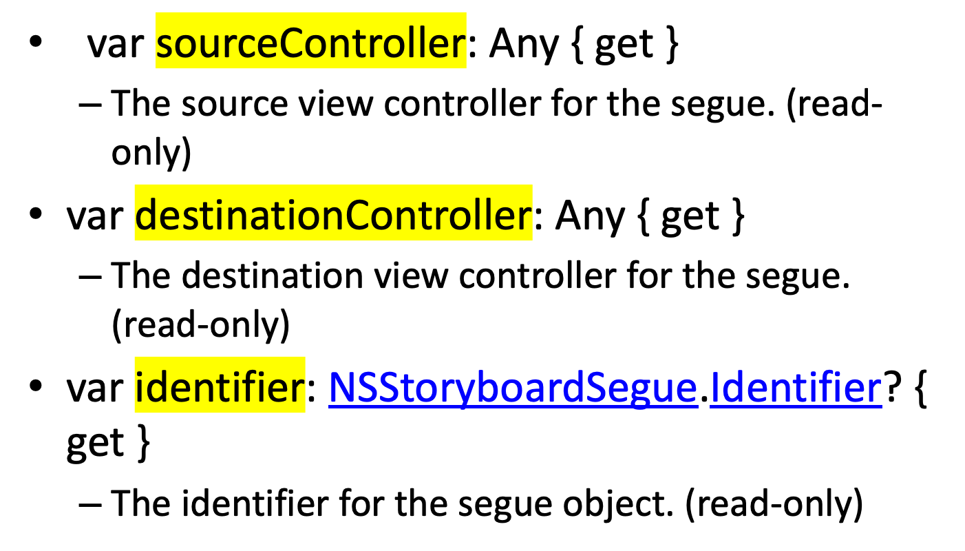
Segue Attributes

Slide 11
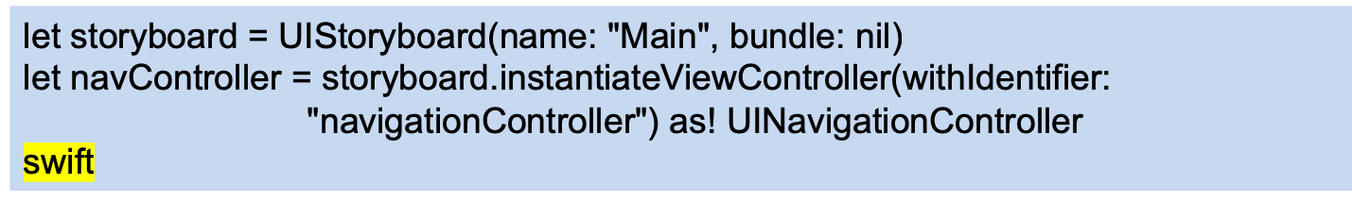
Instantiating a view controller from the storyboard
UIViewController *viewController = [[UIStoryboard
storyboardWithName:@"MainStoryboard" bundle:nil]
instantiateViewControllerWithIdentifier:
@"ViewController"];

Slide 12
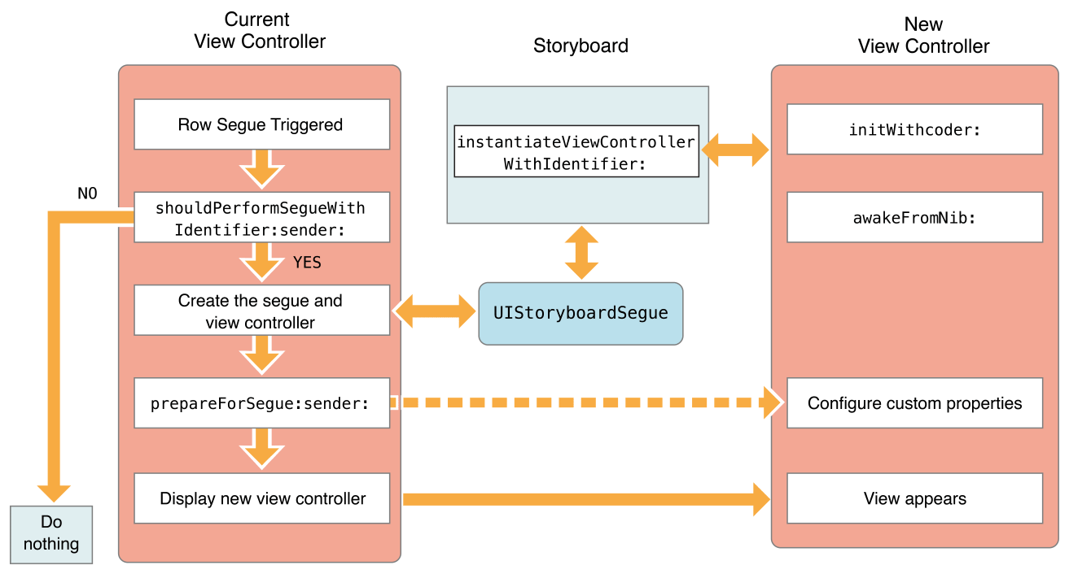
Displaying a view controller using a segue

Slide 13
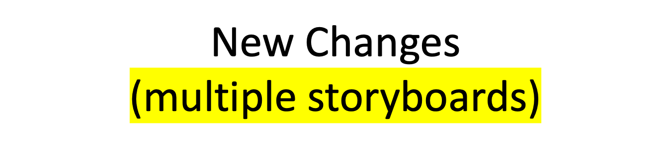
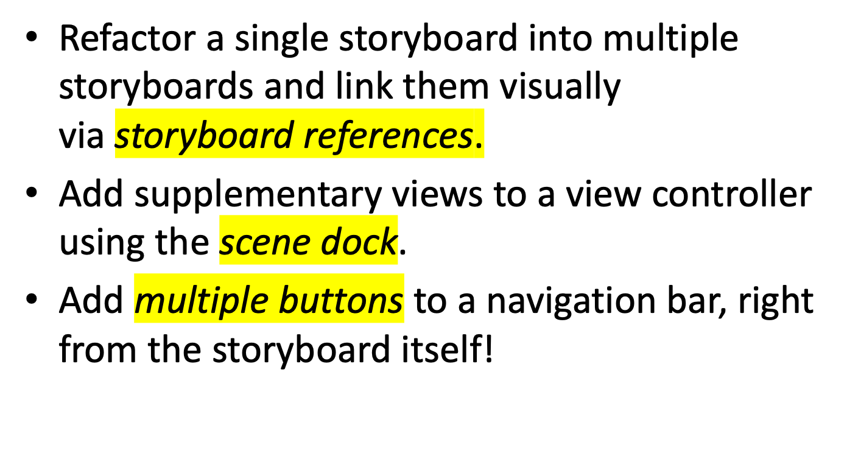

Slide 14
1. Show - Pushes the destination view controller onto the navigation stack, moving the source view controller out of the way (destination slides overtop from right to left), providing a back button to navigate back to the source - on all devices.
Example: Navigating inboxes/folders in Mail.
2. Show Detail - Replaces the detail/secondary view controller when in a UISplitViewController with no ability to navigate back to the previous view controller.
Example: In Mail on iPad in landscape, tapping an email in the sidebar replaces the view controller on the right to show the new email. （split view: right part）
3. Present Modally - Presents a view controller in various different ways as defined by the Presentation option, covering up the previous view controller - most commonly used to present a view controller that animates up from the bottom and covers the entire screen on iPhone, but on iPad it's common to present it in a centered box format overtop that darkens the underlying view controller.
Example: Tapping the + button in Calendar on iPhone.
4. Popover Presentation - When run on iPad, the destination appears in a small popover, and tapping anywhere outside of this popover will dismiss it. On iPhone, popovers are supported as well but by default if it performs a Popover Presentation segue, it will present the destination view controller modally over the full screen.
Example: Tapping the + button in Calendar on iPad (or iPhone, realizing it is converted to a full screen presentation as opposed to an actual popover).
5. Custom - You may implement your own custom segue and have complete control over its appearance and transition.

Slide 15
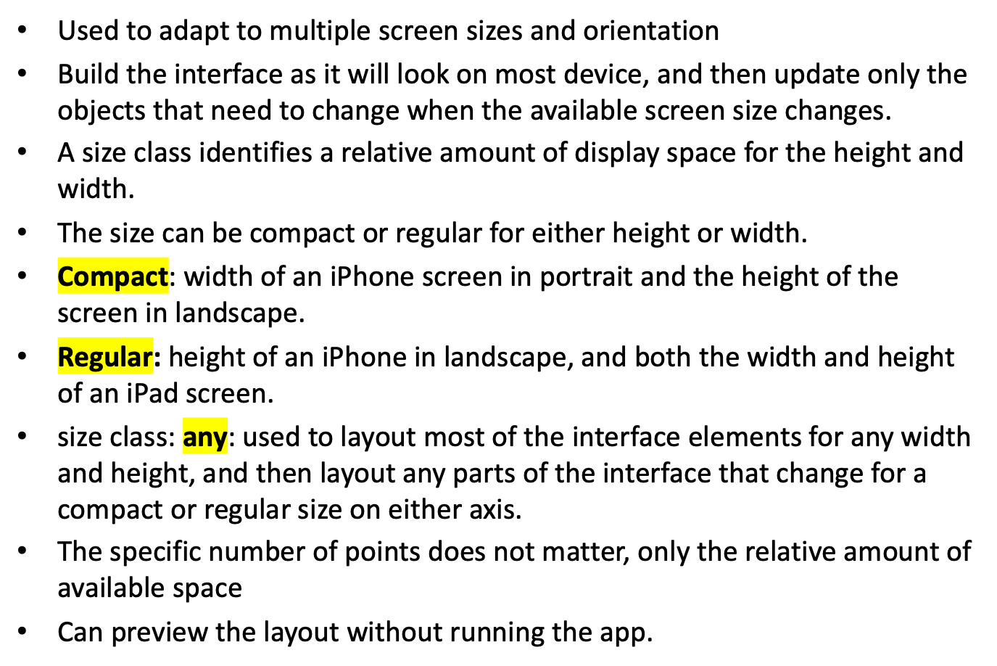
Size Classes

Slide 16
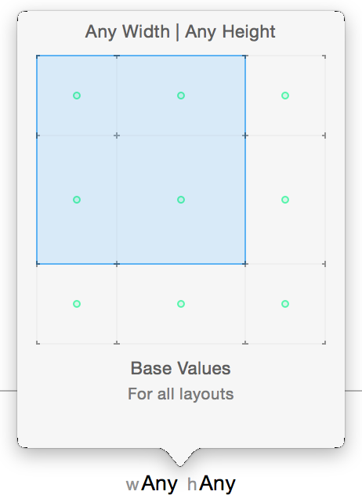

Slide 17
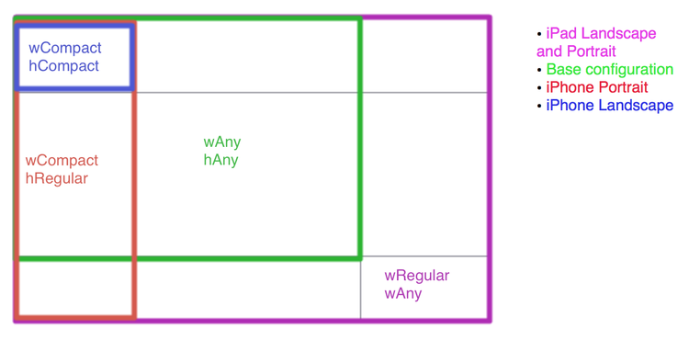

Slide 18
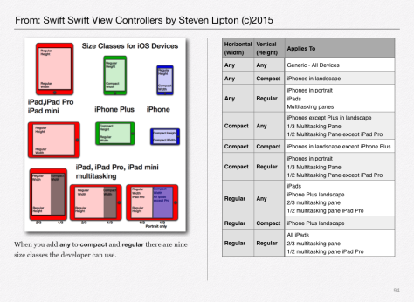

Slide 19
What can be changed?
The constant for a constraint
  Change size or position of a view
If a constraint is installed in the view hierarchy
  Add or remove sets of constraints
If a view is installed in the view hierarchy
  Add or remove a view
The font
  Change the font in labels, text views, and buttons

Slide 20
UITraitEnvironment
Provides iOS interface environment traits:
  horizontal and vertical size class: Regular/Compact
  display scale: 1.0 ( non Retina), 2.0 (Retina or greater)
  user interface idiom: unspecified, Phone, Pad
Protocol adopted by:
  UIScreen, UIWindow, UIViewController, UIPresentationController, and UIView.
traitCollection property: used to access the trait environment of an object

Slide 21
(void) traitCollectionDidChange: (UITraitCollection *) previousTraitCollection {
[super traitCollectionDidChange: previousTraitCollection];
if ((self.traitCollection.verticalSizeClass !=
previousTraitCollection.verticalSizeClass) ||
self.traitCollection.horizontalSizeClass !=
previousTraitCollection.horizontalSizeClass)) {
// your custom implementation here
}
}
func traitCollectionDidChange(_ previousTraitCollection: UITraitCollection?)
The system calls this method when the iOS interface environment changes.
(required) for UITraitEnvironment Protocol

Slide 22
Auto Layout Without Constraints
Use Stack views
A single stack view defines a row or column of user interface elements.
The stack view arranges these elements based on its properties:
    axis: defines the stack view’s orientation, either vertical or horizontal.
    distribution: defines the layout of the views along the axis.
    alignment: defines the layout of the views perpendicular to the stack view’s axis
    spacing: defines the space between adjacent views.

